Slide 1


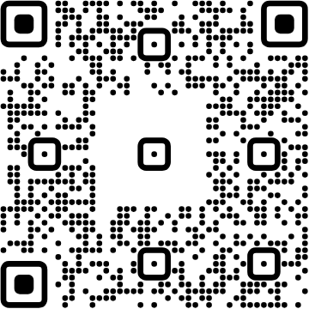
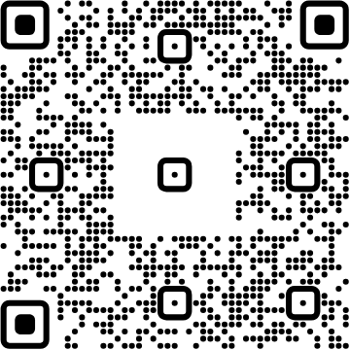
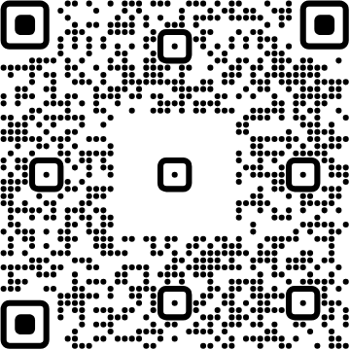




View online
Download PDF
Download PPTX
Vibe Coding:
Let’s Follow the Flow
Luca Del Puppo
Nearform_

Slide 2
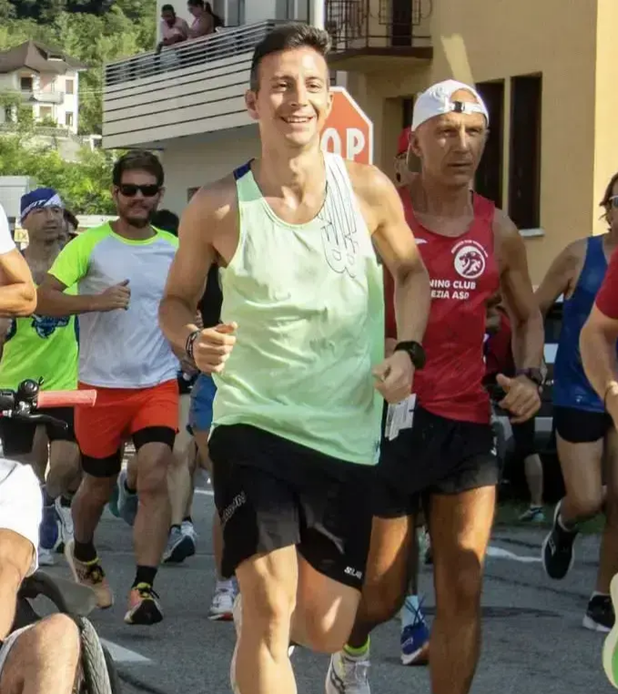

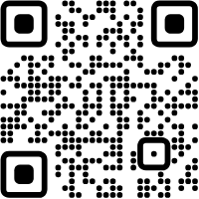




Hi 👋, I'm
Luca
!
Nearform_
AI Native Engineer
GDE
Web Technologies
delpuppo.net
puppo
puppo92
lucadelpuppo

Slide 3
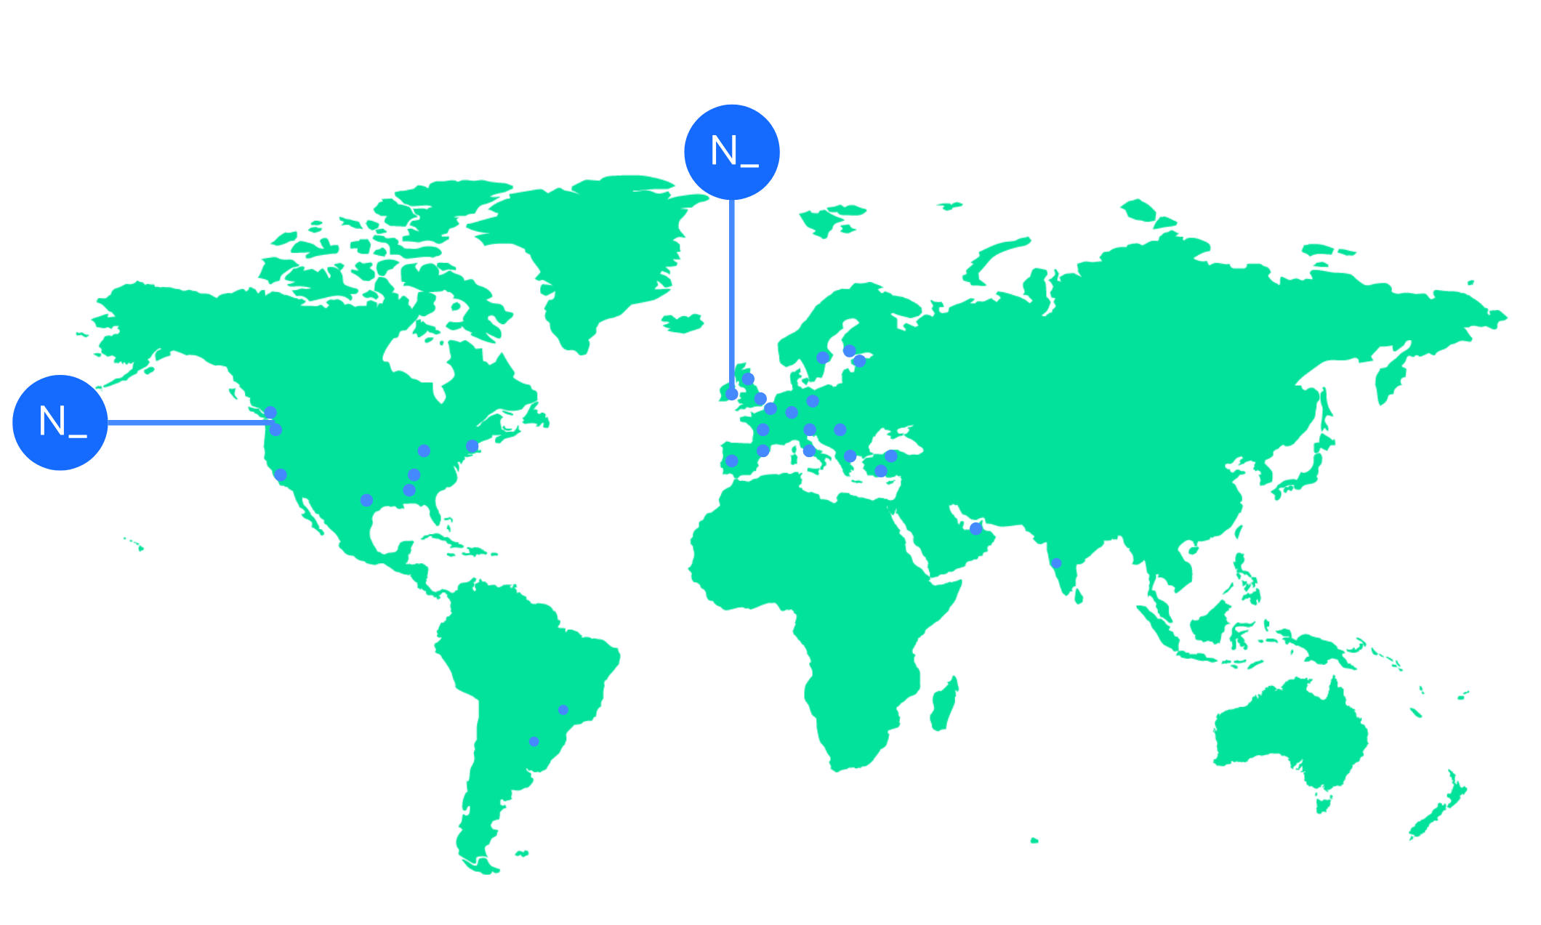

We’re an independent team of engineers, designers and
Nearform’s commitment to Open Source
strategists who build digital solutions and enhanced
capability at pace for ambitious enterprises seeking
15m+
Over 15 million
Downloads
downloads every
enduring business impact.
week
10+
Years experience
700+
Engagements
400+
Nearformers
380+
Customers
1192k+
Thousands of
Contributions
contributions every
28
Countries
year
166+
We maintain many
Packages
popular packages
for the community
We’re hiring!
nearform.com/careers

Slide 4
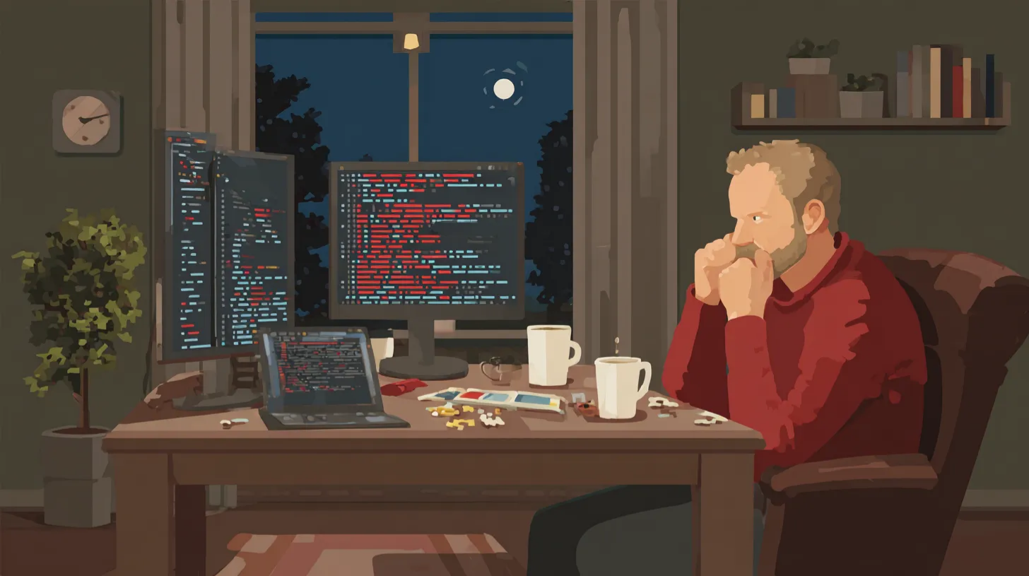
The Old Way
The Manual Process

Slide 5

The Old Way
Writing code line by line, from scratch
The developer writes code without any tools or
shortcuts.
Constantly searching for documentation and
syntax
The developer spends time looking up how to use
different functions and libraries.
Manual debugging, a tedious process
The developer has to go through the code line by line
to find and fix bugs.

Slide 6
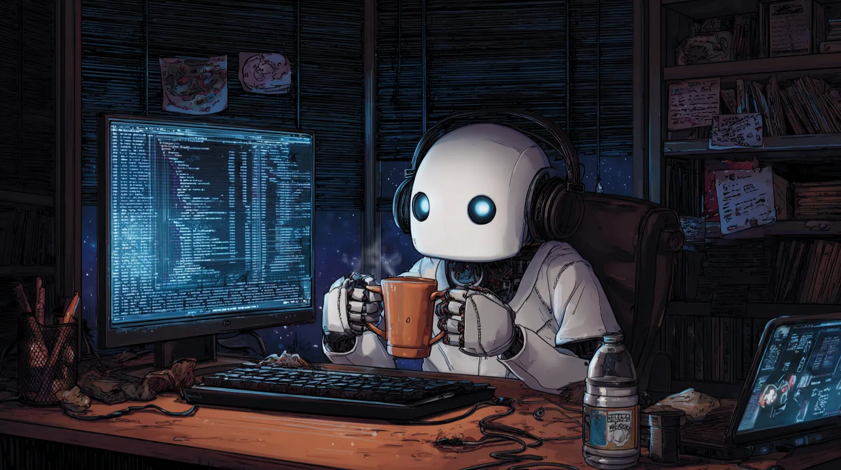
The AI Assistant
A Helping Hand

Slide 7

A Helping Hand
AI suggests code snippets as you type
The AI provides real-time code suggestions to speed
up development
It generates boilerplate code
The AI can create standard code structures, saving
time on repetitive tasks
It answers quick questions about APIs and
frameworks
The AI can provide instant answers to common coding
questions

Slide 8
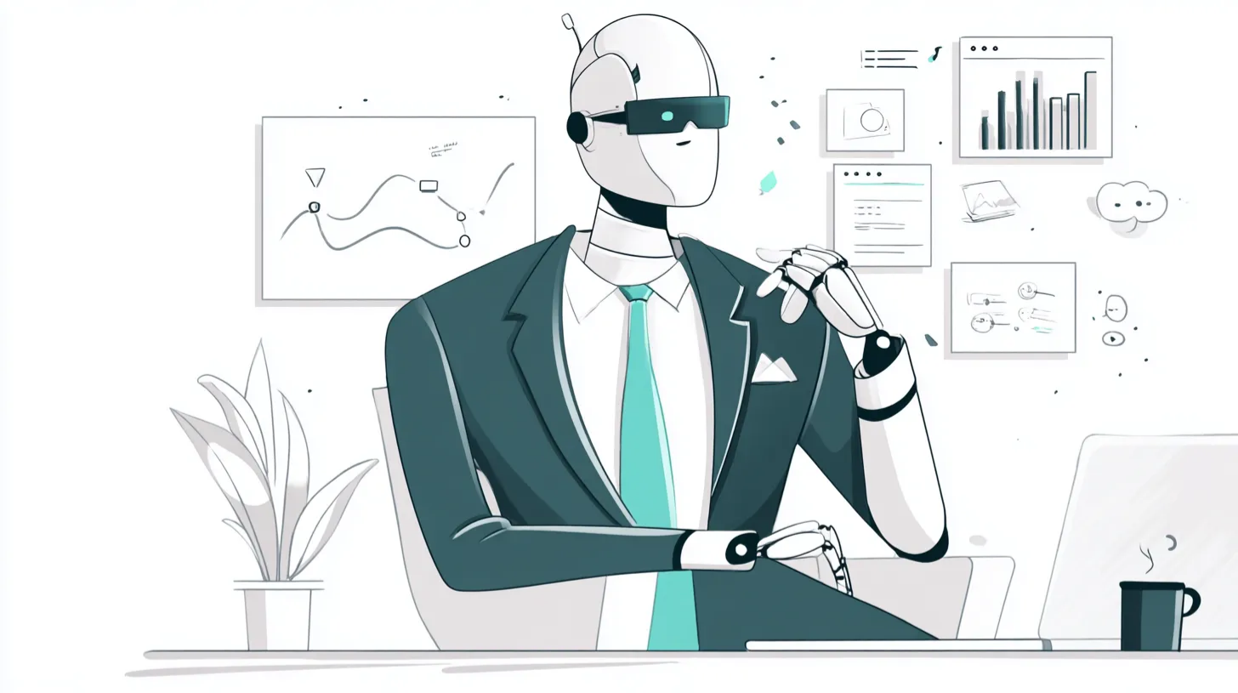
The New Frontier
The Agent

Slide 9
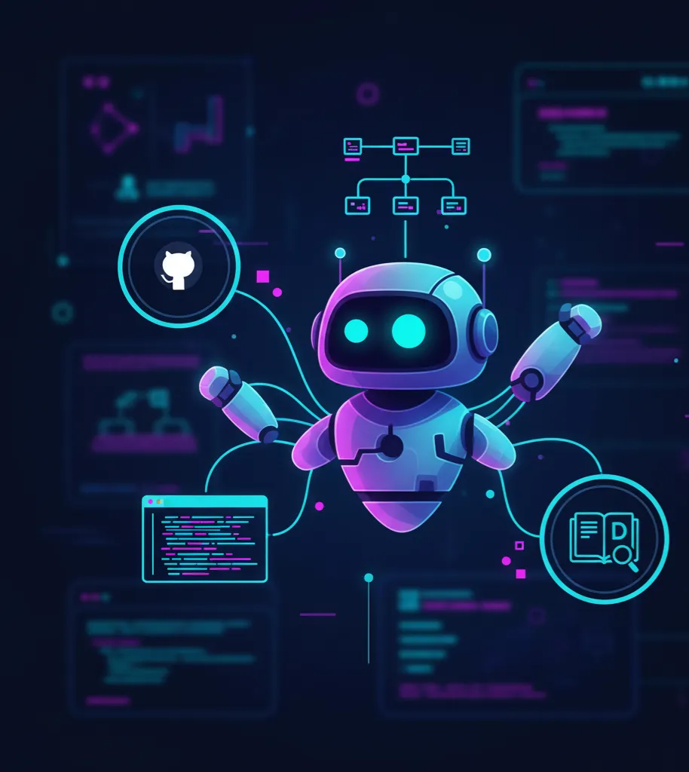
The Agent
The agent takes complex instructions and
executes multi-step tasks
It can understand and follow detailed prompts to
complete tasks
It can manage project workflows
autonomously
The agent can handle tasks like setting up
environments, managing dependencies, and deploying
applications
It acts as a team member, not just a tool
The agent collaborates with developers, contributing to
the project in meaningful ways

Slide 10

Let's play a game!

Slide 11



Let's play a game! 1/2
Senior Developer
Junior Developer

Slide 12



Let's play a game! 2/2
bolt.new
Firebase Studio
GitHub Spark

Slide 13
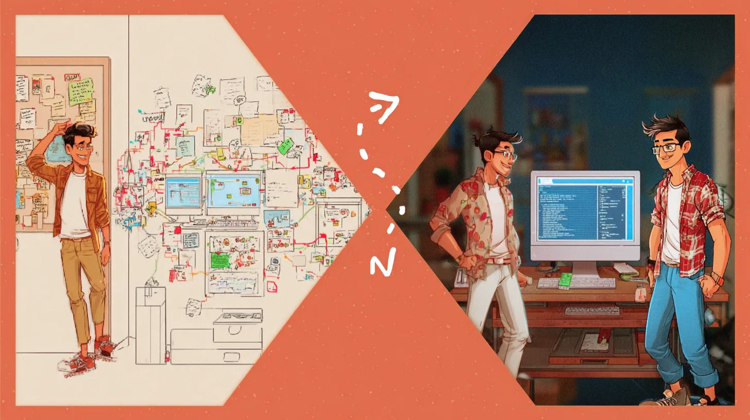
Prototyping <> Development

Slide 14
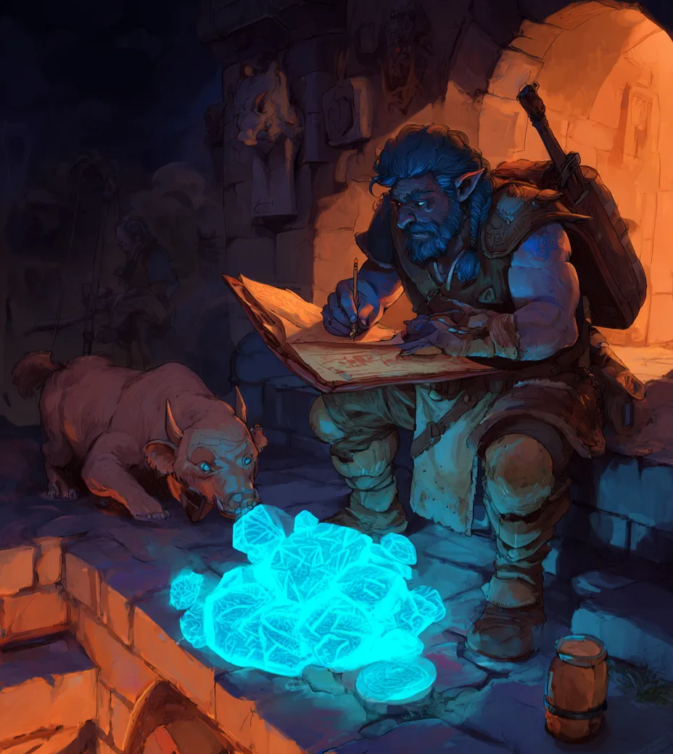
The Art of Prompting
Write clear and specific instructions
The difference between "Create a to-do list app" and
"Using React and Tailwind CSS, create a To-Do list
component that manages state and is accessible to
screen readers."
Is the developer’s role shifting from "code
writer" to instruction engineer?
Crafting effective prompts is becoming a crucial skill
for developers
Clear, constrained instructions lead to better
results
Providing detailed and focused prompts helps the
agent deliver more accurate and relevant code

Slide 15
The Importance of Context
It helps avoid rework and wasted effort
By providing context, the agent can make informed decisions and avoid unnecessary
mistakes.
It ensures the solution aligns with the project’s high-level goals
Context allows the agent to understand the bigger picture and deliver solutions that fit within
the overall project objectives
Context is king 👑
The more context you provide, the better the agent can perform.

Slide 16
The Spec File: Beyond the Prompt
Moving from conversational prompts to structured specifications
This shift allows for more precise and effective communication with the AI
A spec file provides the AI with a complete context of the project
It includes all relevant information, such as project goals, constraints, and requirements
It's the ultimate form of context, enabling the agent to act autonomously
with full awareness
The spec file empowers the agent to make decisions and execute tasks without constant
human intervention

Slide 17
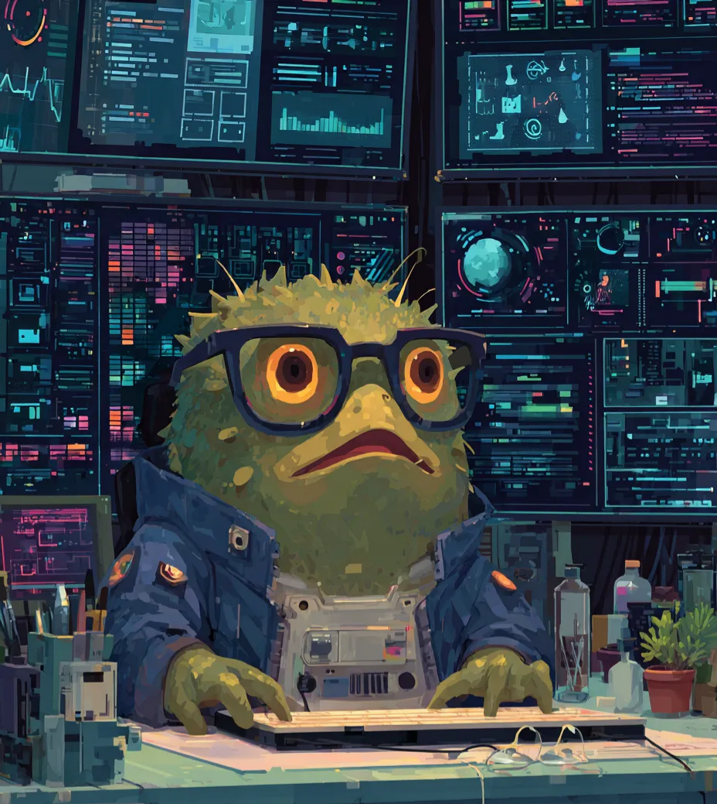
The Agent as a Team
Player 1/2
Agents can manage the codebase, not just
individual files
The agent can understand and navigate the entire
project structure, making it a more effective
collaborator.
Agents can create issues
The agent can identify bugs, suggest features, and
create issues in the project management system.

Slide 18
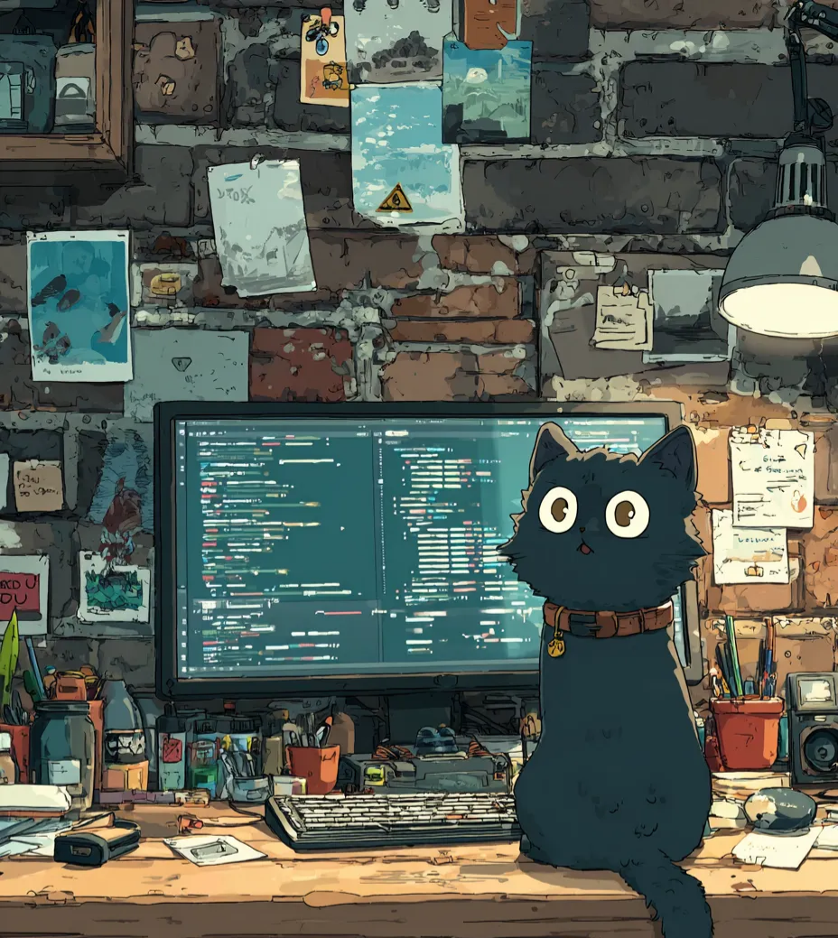
The Agent as a Team
Player 2/2
Automated PR reviews and suggestions
The agent can assist in reviewing pull requests,
providing feedback, and suggesting improvements, or
even creating them.
Helping with project management and
documentation
The agent can help organize tasks, update
documentation, and ensure that the project stays on
track.

Slide 19

Homework for the
curious
BMad Method
A methodology to build software with AI assistance,
focusing on breaking down tasks into manageable
chunks.
Learn more
Spec Driven Development
makes your specification the center of your
engineering process
Learn more

Slide 20
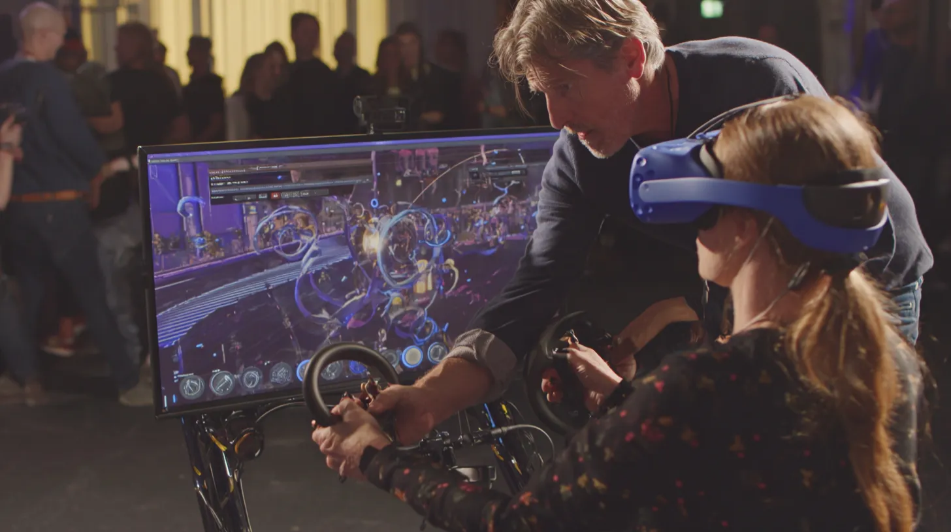
Demo Time!

Slide 21
Conclusion 1/2
Development is changing
The role of developers is evolving with the integration of AI and automation.
Less focus on write tasks, more on high-level design and creativity
Developers can now focus on more complex and creative aspects of software development.

Slide 22
Conclusion 2/2
AI and agents are our collaborators, not replacements
Embracing these tools can enhance productivity and innovation.
Embrace the flow and let the agents handle the routine
By allowing AI to take care of repetitive tasks, developers can concentrate on higher-level
problem-solving and innovation.

Slide 23

Enjoy the journey!

Slide 24


Thank you!
Luca Del Puppo
@puppo92
Nearform_
luca@delpuppo.net

Slide 25
Bye Bye 👋, I'm
Luca
!
Nearform_
AI Native Engineer
GDE
Web Technologies
delpuppo.net
puppo
puppo92
lucadelpuppo

Slide 26

Questions

Slide 27
View online
Download PDF
Download PPTX
Vibe Coding: Let’s Follow
the Flow
Luca Del Puppo
Nearform_

