Slide 1









View online
Download PDF
Download PPTX
React Compiler
how can you help me?
Luca Del Puppo
Nearform_

Slide 2







Hi 👋, I'm
Luca
!
Nearform_
AI Native Engineer
GDE
Web Technologies
delpuppo.net
puppo
puppo92
lucadelpuppo

Slide 3
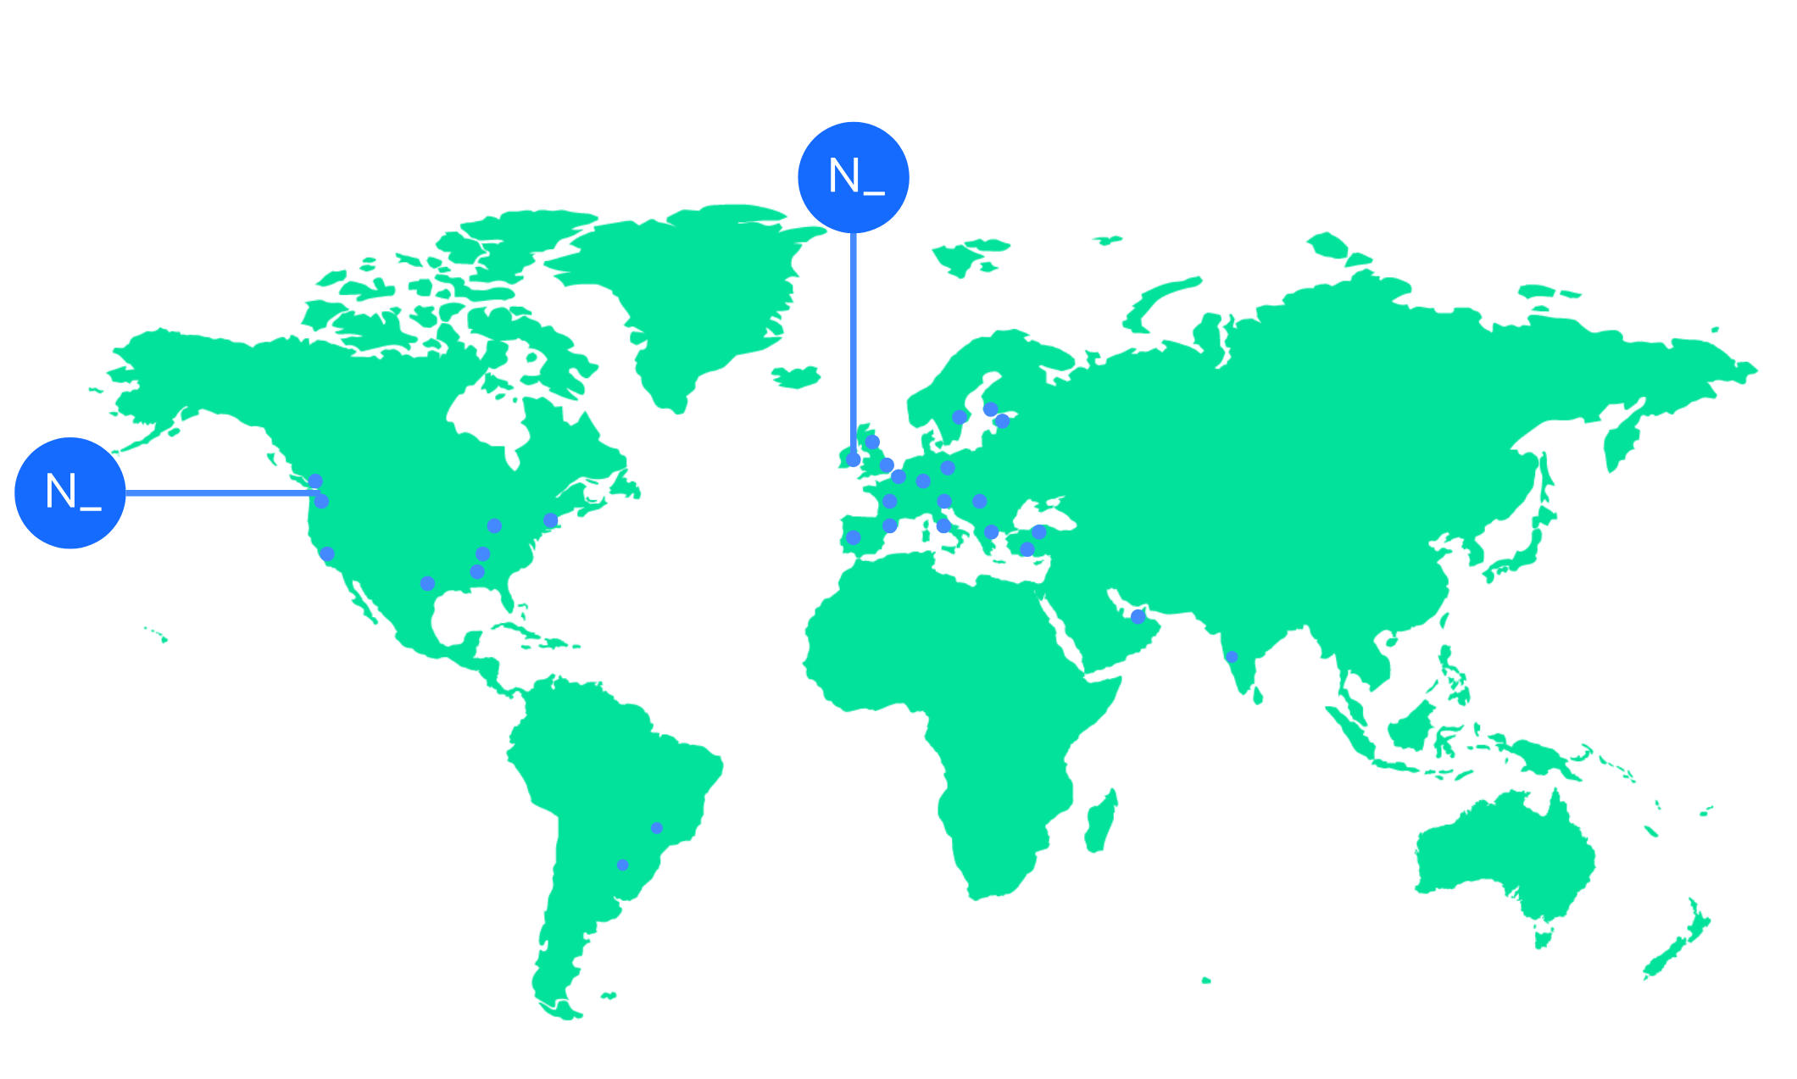

We’re an independent team of engineers, designers and
Nearform’s commitment to Open Source
strategists who build digital solutions and enhanced
capability at pace for ambitious enterprises seeking
15m+
Over 15 million
Downloads
downloads every
enduring business impact.
week
10+
Years experience
700+
Engagements
400+
Nearformers
380+
Customers
1192k+
Thousands of
Contributions
contributions every
28
Countries
year
166+
We maintain many
Packages
popular packages
for the community
We’re hiring!
nearform.com/careers

Slide 4

Why are we here to
talk about React
Compiler?

Slide 5

Long story short

Slide 6
React Story
1
2013: Birth of React
Invented to fix AngularJS
2
2019: React Hooks
Invented to fix React's
3
2021: React Suspense
Invented to fix React again
4
2024: React Compiler
Invented to fix React again again

Slide 7
🔴 2019: React Hooks 🔴
1
memo
Avoid re-rendering
2
useMemo
Optimize expensive calculations
3
useCallback
Memoize callback functions

Slide 8



The Burden of Manual
Memoization
Parent State Changes
Triggers re-render of Parent
ALL Children Re-render
Even if props/state didn't change
Slow UI 🐢
Causes slow UI updates

Slide 9

Let's see it in action

Slide 10

We have a new
hero in town
React
Compiler

Slide 11
Install it
1
npm install -D babel-plugin-react-compiler@latest

Slide 12
Enable it
import react from '@vitejs/plugin-react'
import { defineConfig } from 'vite'
export default defineConfig({
plugins: [
react({
babel: {
plugins: [['babel-plugin-react-compiler']],
},
}),
],
})
2

Slide 13


Let's be precise
It's not a real Compiler
⁉️ another mistake?
It's a Babel Plugin
Transforms your code
Adds optimizations
Like auto-memoization

Slide 14

Let's see it in action

Slide 15

What can go wrong?

Slide 16
Caveats & Best Practices
1
The compiler isn't magic
2
It relies on you following the Rules of React.
3
State is Immutable.

Slide 17

Check React Compiler is working
properly

Slide 18
Health check npm script
1
npx react-compiler-healthcheck@latest

Slide 19
ESLint React Hooks plugin
1
npm i -D eslint-plugin-react-hooks@latest

Slide 20
Check the build artifacts
1
2
3
...
Symbol.for("react.memo_cache_sentinel")
...

Slide 21
Let's see it in action

Slide 22

This is cool but...
It works well for greenfield projects

Slide 23

What about legacy code?

Slide 24
Incremental Adoption Strategy
Babel overrides
Apply the compiler to specific directories
Opt-in with “use memo”
Only compile components that explicitly opt in
Runtime gating
Control compilation with feature flags

Slide 25
Let's see it in action

Slide 26
Conclusion 1/2
React Compiler is here to help you
No more manual memoization
React Compiler is not magic
Follow the Rules of React
React Compiler is just a tool
‼️ Test, measure, verify the output ‼️

Slide 27
Conclusion 2/2
React Compiler
still in RC
is HERE
It's stable
but not perfect
Give it a try!
Start using it in your projects

Slide 28
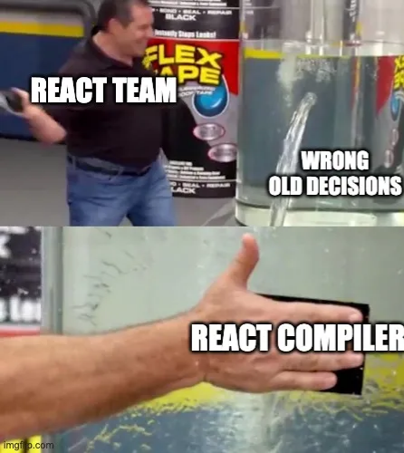
Let's be precise
This
is
my
opinion
about
React
Compiler

Slide 29
Links
React Compiler
https://react.dev/learn/react-compiler/
I tried React Compiler today, and guess what... 😉
https://www.developerway.com/posts/i-tried-react-compiler

Slide 30
Videos 1/2
React Compiler Explained in 3 Minutes (Goodbye, re-renders)
https://www.youtube.com/watch?v=40osg7LoShc
React Compiler Internals
https://www.youtube.com/watch?v=Pw8w2O5Y0no
Ready for everyday use?
https://www.youtube.com/watch?v=guKq_qumTV8

Slide 31
Videos 2/2
The Problem With the React Compiler
https://www.youtube.com/watch?v=14MZJtGAiVs
They made React great again? 🎡
https://www.youtube.com/watch?v=4k6Xgjqkad4

Slide 32


Thank you!
Luca Del Puppo
@puppo92
Nearform_
luca@delpuppo.net

Slide 33

GitHub Repo
React Compiler Talk
Explore the code and examples

Slide 34
Bye Bye 👋, I'm
Luca
!
Nearform_
AI Native Engineer
GDE
Web Technologies
delpuppo.net
puppo
puppo92
lucadelpuppo

Slide 35

Questions

Slide 36
View online
Download PDF
Download PPTX
React Compiler how can
you help me?
Luca Del Puppo
Nearform_

