Slide 1


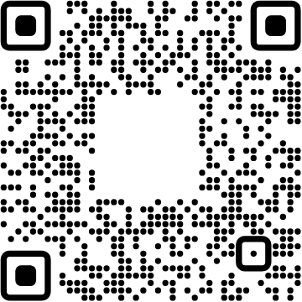
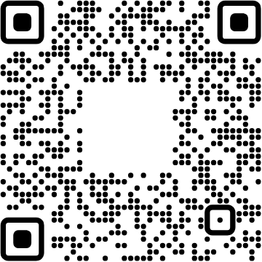
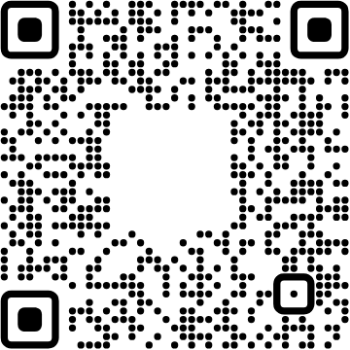




View online
Download PDF
Download PPTX
Don't trust your types
Type testing with TSTyche
Luca Del Puppo
Nearform_

Slide 2







Hi 👋, I'm
Luca
!
Nearform_
AI Native Engineer
GDE
Web Technologies
delpuppo.net
puppo
puppo92
lucadelpuppo

Slide 3
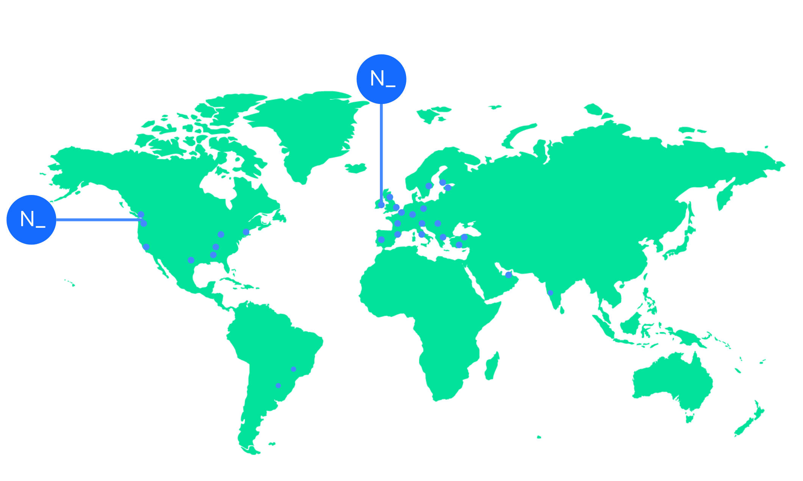

We’re an independent team of engineers, designers and
Nearform’s commitment to Open Source
strategists who build digital solutions and enhanced
capability at pace for ambitious enterprises seeking
15m+
Over 15 million
Downloads
downloads every
enduring business impact.
week
10+
Years experience
700+
Engagements
400+
Nearformers
380+
Customers
1192k+
Thousands of
Contributions
contributions every
28
Countries
year
166+
We maintain many
Packages
popular packages
for the community
We’re hiring!
nearform.com/careers

Slide 4

A green build can still ship a broken developer
experience
We will debate semicolons for hours.
1
Then we treat generic inference as an act of faith.
A refactor from T to any can erase autocomplete without
breaking the build.

Slide 5

Runtime behavior ≠ type-time contract
Runtime tests
Does the Fastify route return the right response?
Type tests
2
Can a consumer call the route with the right params, query, and reply?
The gap
JavaScript can behave perfectly while the public types quietly decay.

Slide 6
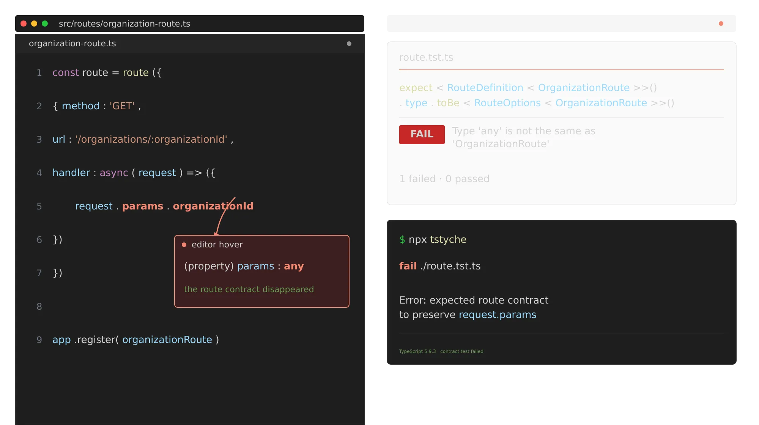
The editor is where your API is
experienced

Slide 7

Make contracts
executable
Type testing with TSTyche

Slide 8
What TSTyche brings to the table
1
A test runner for types
Familiar test files, assertions, focused failures.
2
The TypeScript language service
3
The same type-checking view behind editor hovers.
3
Compatibility targets
Run one contract suite against more than one TypeScript version.

Slide 9
First test in 60 seconds
4
1
2
3
4
npm add -D tstyche
# route.tst.ts
npx tstyche

Slide 10
A tiny Fastify package with a public contract
1
2
3
4
5
6
7
8
9
10
11
12
13
14
15
16
import type { FastifyPluginAsync, RouteGenericInterface, RouteOptions } from 'fastify'
export type RouteContract = RouteGenericInterface
export type RouteDefinition<T extends RouteContract> =
RouteOptions<T>
// re-exported so consumers can write equality tests against the underlying type
export type { RouteOptions }
export type RouteFactory = <T extends RouteContract>(
definition: RouteDefinition<T>,
) => FastifyPluginAsync
export const route: RouteFactory = definition => async fastify => {
fastify.route(definition)
}
5

Slide 11
The regression is one character wide
6
1
2
3
4
5
6
7
8
9
// Before: inference carries the consumer's route contract
export type RouteDefinition<T extends RouteContract> =
RouteOptions<T>
// After a harmless-looking refactor...
export type RouteDefinition<T extends RouteContract> =
RouteOptions<any>
// The app still starts. The user's hover now says: any.

Slide 12
Equality catches the silent any
1
2
3
4
5
6
7
8
9
10
11
12
13
14
15
16
17
18
19
20
21
22
23
24
25
26
27
28
import { expect, test } from 'tstyche'
import { route } from 'fastify-route-contracts'
import type {
RouteDefinition,
RouteOptions
} from 'fastify-route-contracts'
type OrganizationRoute = {
Params: { organizationId: string }
Querystring: { include?: 'members' | 'projects' }
Reply: { id: string; name: string }
}
const organizationDefinition: RouteDefinition<OrganizationRoute> = {
method: 'GET',
url: '/organizations/:organizationId',
handler: async request => ({
id: request.params.organizationId,
name: 'Acme'
})
}
test('RouteDefinition preserves its generic', () => {
// Fails the moment RouteDefinition widens to RouteOptions.
expect<RouteDefinition<OrganizationRoute>>().type.toBe<
RouteOptions<OrganizationRoute>
>()
})
7

Slide 13
Can a consumer call it?
1
2
3
4
5
6
7
8
9
10
11
12
13
14
15
16
17
18
19
20
21
22
23
24
25
import { expect, test } from 'tstyche'
import { route } from 'fastify-route-contracts'
import type {
RouteDefinition,
RouteOptions
} from 'fastify-route-contracts'
type OrganizationRoute = {
Params: { organizationId: string }
Querystring: { include?: 'members' | 'projects' }
Reply: { id: string; name: string }
}
const organizationDefinition: RouteDefinition<OrganizationRoute> = {
method: 'GET',
url: '/organizations/:organizationId',
handler: async request => ({
id: request.params.organizationId,
name: 'Acme'
})
}
test('route factory accepts the intended definition', () => {
expect(route).type.toBeCallableWith(organizationDefinition)
})
8

Slide 14
Reject bad input before runtime
1
2
3
4
5
6
7
8
9
10
11
12
13
14
15
16
17
18
19
20
21
22
23
24
25
26
27
28
import { expect, test } from 'tstyche'
import { route } from 'fastify-route-contracts'
import type {
RouteDefinition,
RouteOptions
} from 'fastify-route-contracts'
type OrganizationRoute = {
Params: { organizationId: string }
Querystring: { include?: 'members' | 'projects' }
Reply: { id: string; name: string }
}
test('a bad reply shape is rejected', () => {
expect(route).type.not.toBeCallableWith({
method: 'GET',
url: '/organizations/:organizationId',
handler: async () => ({ id: 42, name: 'Acme' }),
})
})
test('a missing route param is rejected', () => {
expect(route).type.not.toBeCallableWith({
method: 'GET',
url: '/organizations',
handler: async () => ({ id: 'x', name: 'Acme' }),
})
})
9

Slide 15
One suite, multiple TypeScript versions
10
1
2
3
4
5
# The package supports both compiler generations
npx tstyche --target '5.4 || 5.9'
# Or let CI cover every supported minor release
npx tstyche --target '>=5.4'

Slide 16
Make CI protect the package contract
1
2
3
4
5
6
7
8
9
{
"scripts": {
"test:types": "tstyche",
"test:types:compat": "tstyche --target '5.4 || 5.9'"
},
"devDependencies": {
"tstyche": "latest"
}
}
11

Slide 17
The feedback loop is deliberately small
Edit
Change the generic or the declaration file.
Hover
12
See the consumer-facing type in VS Code.
Test
TSTyche checks the same language-service view.
Ship
CI prevents a type contract from regressing silently.

Slide 18

Types are active
documentation
Start with the public type contract your users
depend on.

Slide 19
Give your coding agent the TSTyche playbook
13
1
2
3
4
5
6
npx skills add tstyche/tstyche-skills
# Choose the workflow you need
# tstyche-type-tests assertions, inference, compatibility
# tstyche-project-setup config, CLI, watch mode, CI
# tstyche-programmatic-api runners, reporters, embedded runs

Slide 20
Live demo: make the type contract fail
14
1
2
3
4
5
6
git clone https://github.com/Puppo/dont-trust-your-types
cd dont-trust-your-types
npm test # runtime stays green
npm run test:types # the contract catches the refactor
npm run test:types:compat

Slide 21
Keep exploring
TSTyche
https://tstyche.org
Fastify TypeScript
https://fastify.dev/docs/latest/Reference/TypeScript/
15
Talk demo repo
https://github.com/Puppo/dont-trust-your-types

Slide 22


Thank you!
Luca Del Puppo
@puppo92
Nearform_
luca@delpuppo.net

Slide 23
Bye Bye 👋, I'm
Luca
!
Nearform_
AI Native Engineer
GDE
Web Technologies
delpuppo.net
puppo
puppo92
lucadelpuppo

Slide 24
View online
Download PDF
Download PPTX
Don't trust your types Type
testing with TSTyche
Luca Del Puppo
Nearform_

