Slide 1


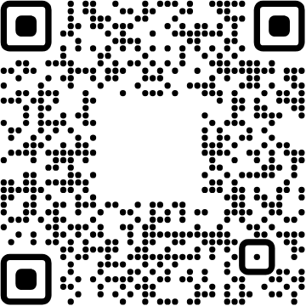
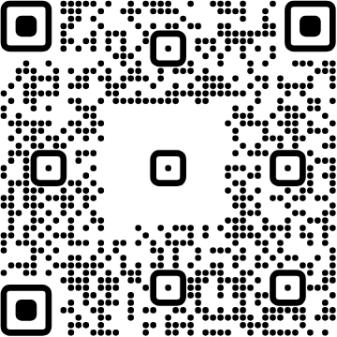
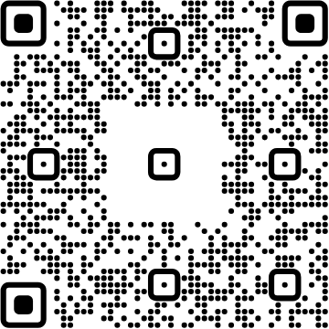




View online
Download PDF
Download PPTX
Costruiamo agenti con
ADK-js
Luca Del Puppo
Nearform_

Slide 2
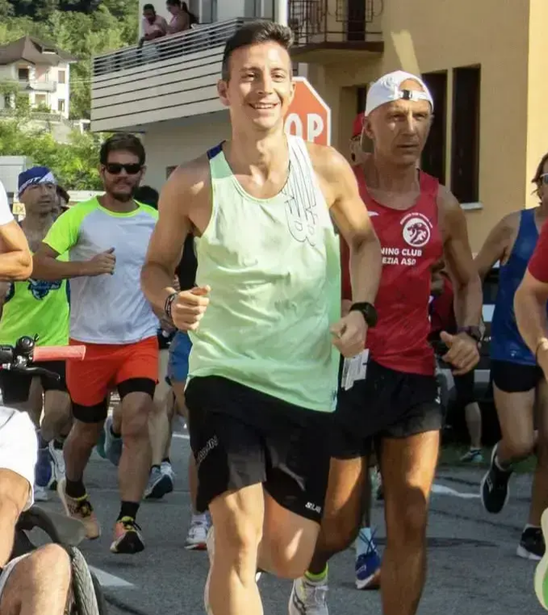
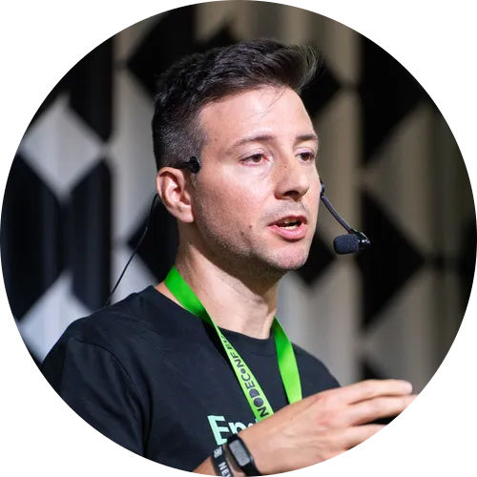
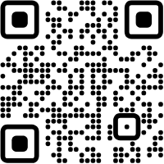




Hi 👋, I'm
Luca
!
Nearform_
AI Native Engineer
GDE
Web Technologies
delpuppo.net
puppo
puppo92
lucadelpuppo

Slide 3
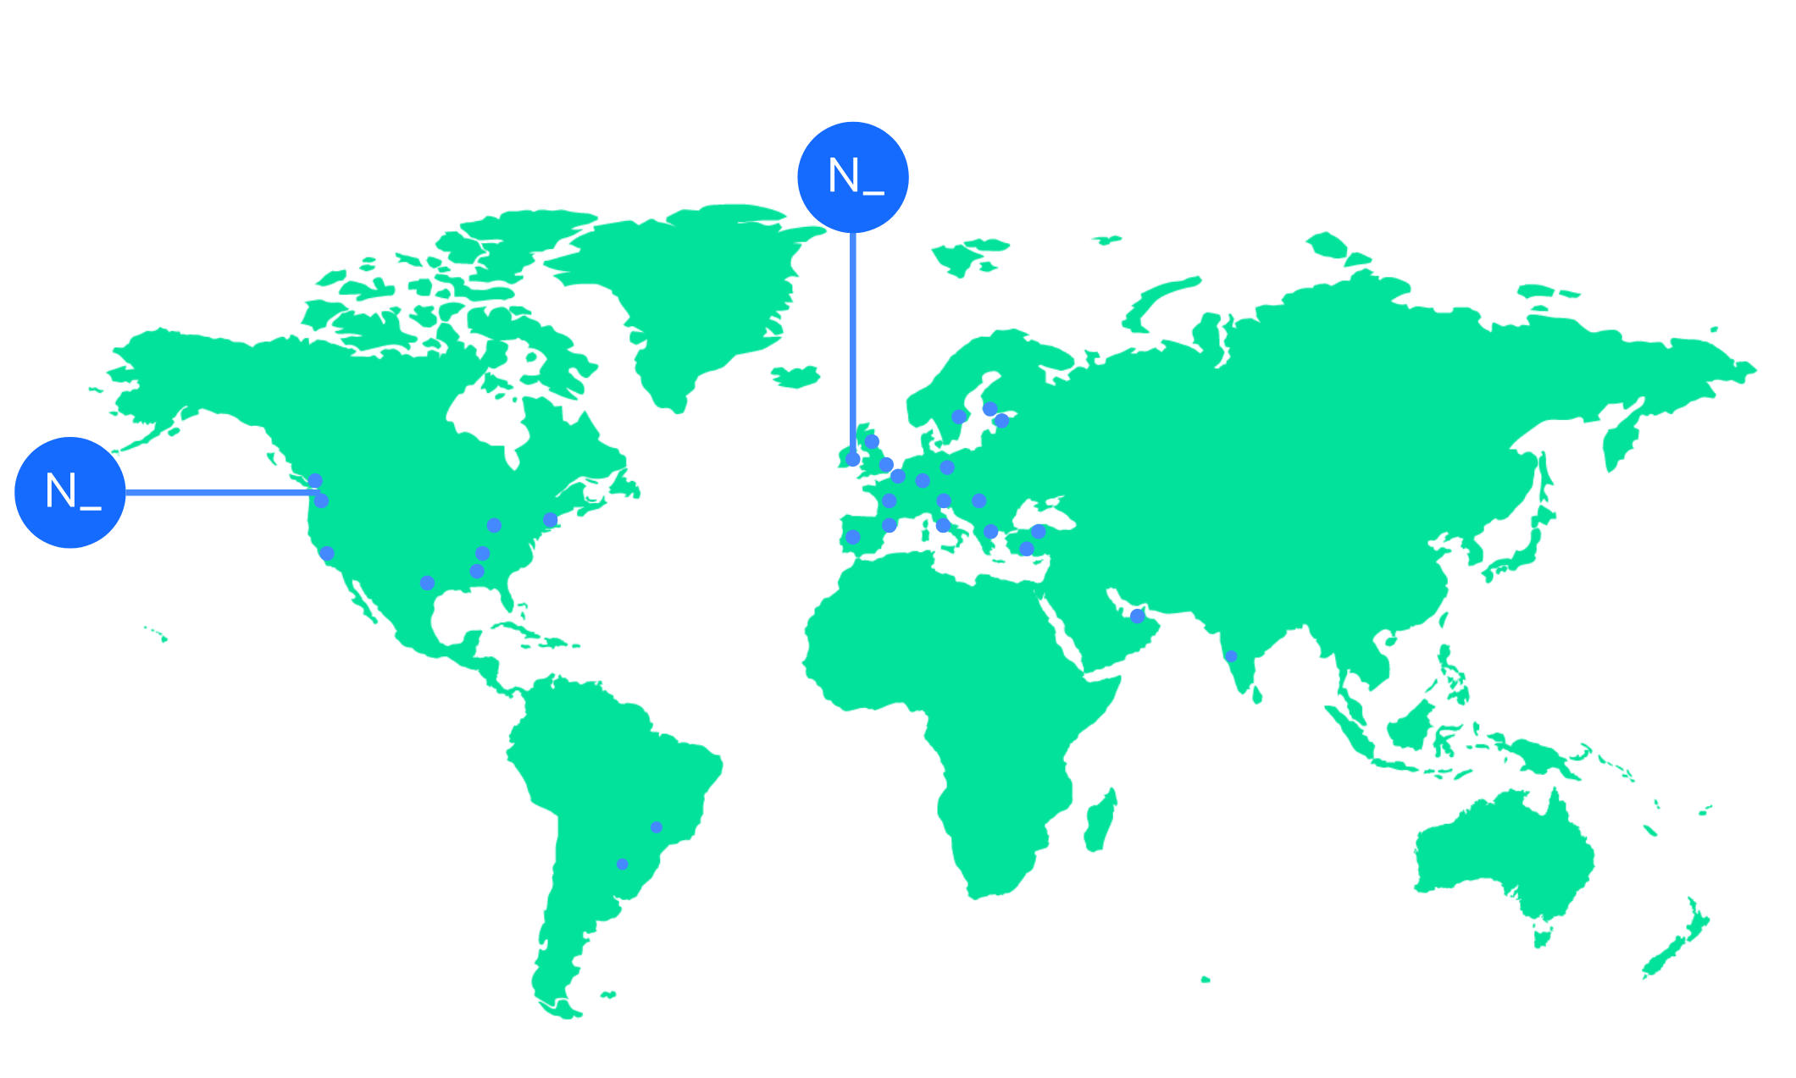

We’re an independent team of engineers, designers and
Nearform’s commitment to Open Source
strategists who build digital solutions and enhanced
capability at pace for ambitious enterprises seeking
15m+
Over 15 million
Downloads
downloads every
enduring business impact.
week
10+
Years experience
700+
Engagements
400+
Nearformers
380+
Customers
1192k+
Thousands of
Contributions
contributions every
28
Countries
year
166+
We maintain many
Packages
popular packages
for the community
We’re hiring!
nearform.com/careers

Slide 4
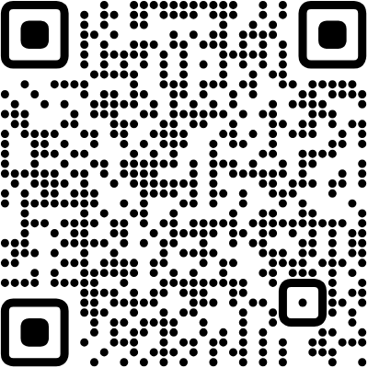

Workshop Repository
GitHub Repository
github.com/Puppo/adk-js-codelabs

Slide 5
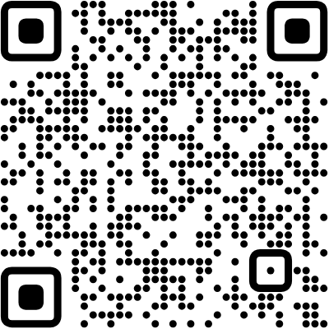
Credits
Credits

Slide 6
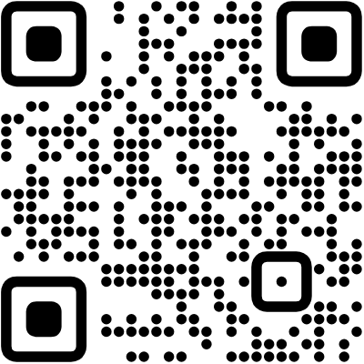
Get your API Key
API Keys
bit.ly/4tvWKgK

Slide 7
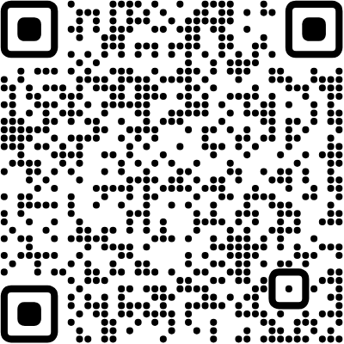
ADK Course - Python
ADK Course - Python
github.com/mauripsale/doc-adk-training/

Slide 8


Thank you!
Luca Del Puppo
@puppo92
Nearform_
luca@delpuppo.net

Slide 9
Bye Bye 👋, I'm
Luca
!
Nearform_
AI Native Engineer
GDE
Web Technologies
delpuppo.net
puppo
puppo92
lucadelpuppo

Slide 10
View online
Download PDF
Download PPTX
Costruiamo agenti con
ADK-js
Luca Del Puppo
Nearform_

