Slide 1


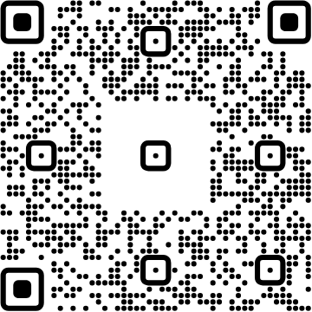
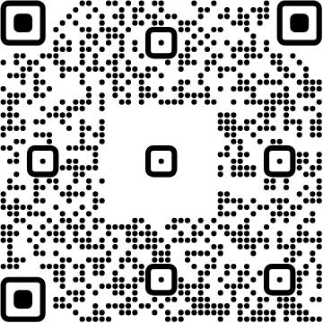
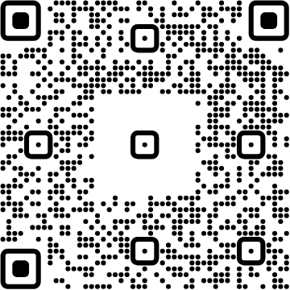




View online
Download PDF
Download PPTX
ChromeDevTools
for super fast SSR
applications
Luca Del Puppo
Nearform_

Slide 2







Hi 👋, I'm
Luca
!
Nearform_
AI Native Engineer
GDE
Web Technologies
delpuppo.net
puppo
puppo92
lucadelpuppo

Slide 3
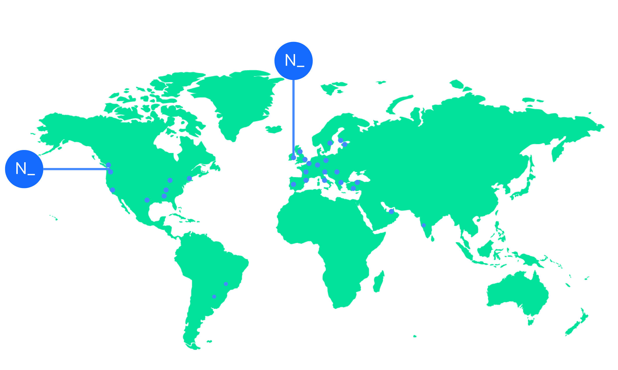

We’re an independent team of engineers, designers and
Nearform’s commitment to Open Source
strategists who build digital solutions and enhanced
capability at pace for ambitious enterprises seeking
15m+
Over 15 million
Downloads
downloads every
enduring business impact.
week
10+
Years experience
700+
Engagements
400+
Nearformers
380+
Customers
1192k+
Thousands of
Contributions
contributions every
28
Countries
year
166+
We maintain many
Packages
popular packages
for the community
We’re hiring!
nearform.com/careers

Slide 4
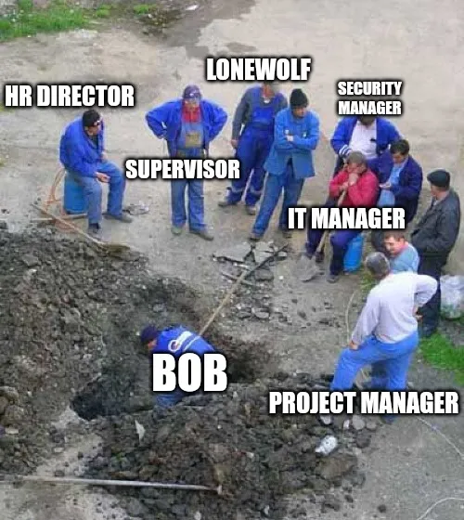

This is a common
situation nowadays
I
know
Bob
is
facing
your
same
challenges.

Slide 5

Developers should take care of 1/2
User Experience
Performance
Accessibility
SEO

Slide 6
Developers should take care of 2/2
Best Practices
Security
SSR

Slide 7

How can we debug
all of them?

Slide 8

Chrome DevTools
exposes useful
features to debug
them

Slide 9
Different tabs 1/2
Performance
Accessibility / Accessibility Tree
Lighthouse

Slide 10
Different tabs 2/2
Network
Coverage
MCP Server

Slide 11

Let's get started!

Slide 12
Links
Chrome DevTools Docs
https://developer.chrome.com/docs/devtools
Chrome for Developers YouTube Channel
https://www.youtube.com/@ChromeDevs

Slide 13


Thank you!
Luca Del Puppo
@puppo92
Nearform_
luca@delpuppo.net

Slide 14
Bye Bye 👋, I'm
Luca
!
Nearform_
AI Native Engineer
GDE
Web Technologies
delpuppo.net
puppo
puppo92
lucadelpuppo

Slide 15
View online
Download PDF
Download PPTX
ChromeDevTools for super
fast SSR applications
Luca Del Puppo
Nearform_

