Slide 1


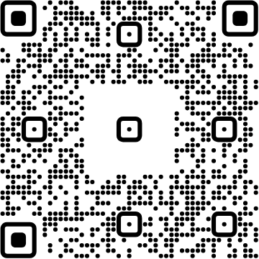
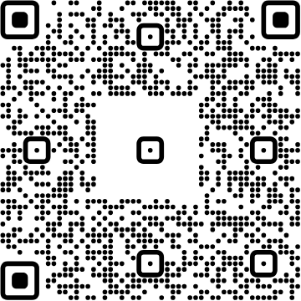
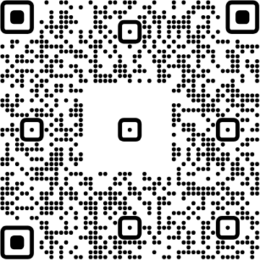




View online
Download PDF
Download PPTX
ChromeDevTools
are you confident in your
expertise?
Luca Del Puppo
Nearform_

Slide 2







Hi 👋, I'm
Luca
!
Nearform_
AI Native Engineer
GDE
Web Technologies
delpuppo.net
puppo
puppo92
lucadelpuppo

Slide 3
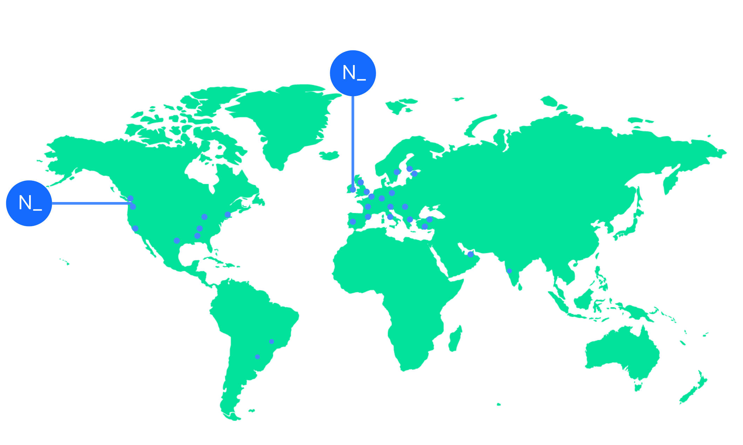

We’re an independent team of engineers, designers and
Nearform’s commitment to Open Source
strategists who build digital solutions and enhanced
capability at pace for ambitious enterprises seeking
15m+
Over 15 million
Downloads
downloads every
enduring business impact.
week
10+
Years experience
700+
Engagements
400+
Nearformers
380+
Customers
1192k+
Thousands of
Contributions
contributions every
28
Countries
year
166+
We maintain many
Packages
popular packages
for the community
We’re hiring!
nearform.com/careers

Slide 4

Who work with
JavaScript?

Slide 5

Who usually uses
DevTools?

Slide 6

How many of you
debug using
console.log?

Slide 7
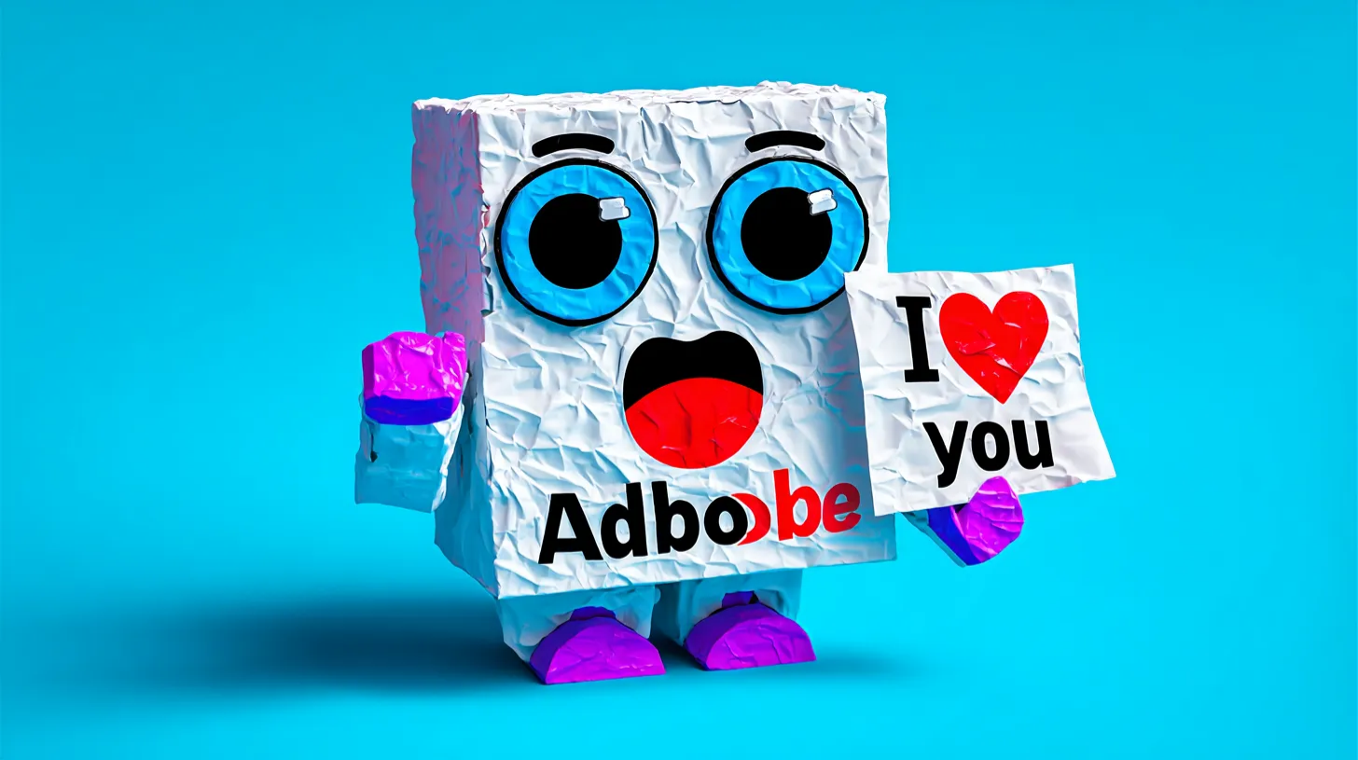
I love you all!

Slide 8
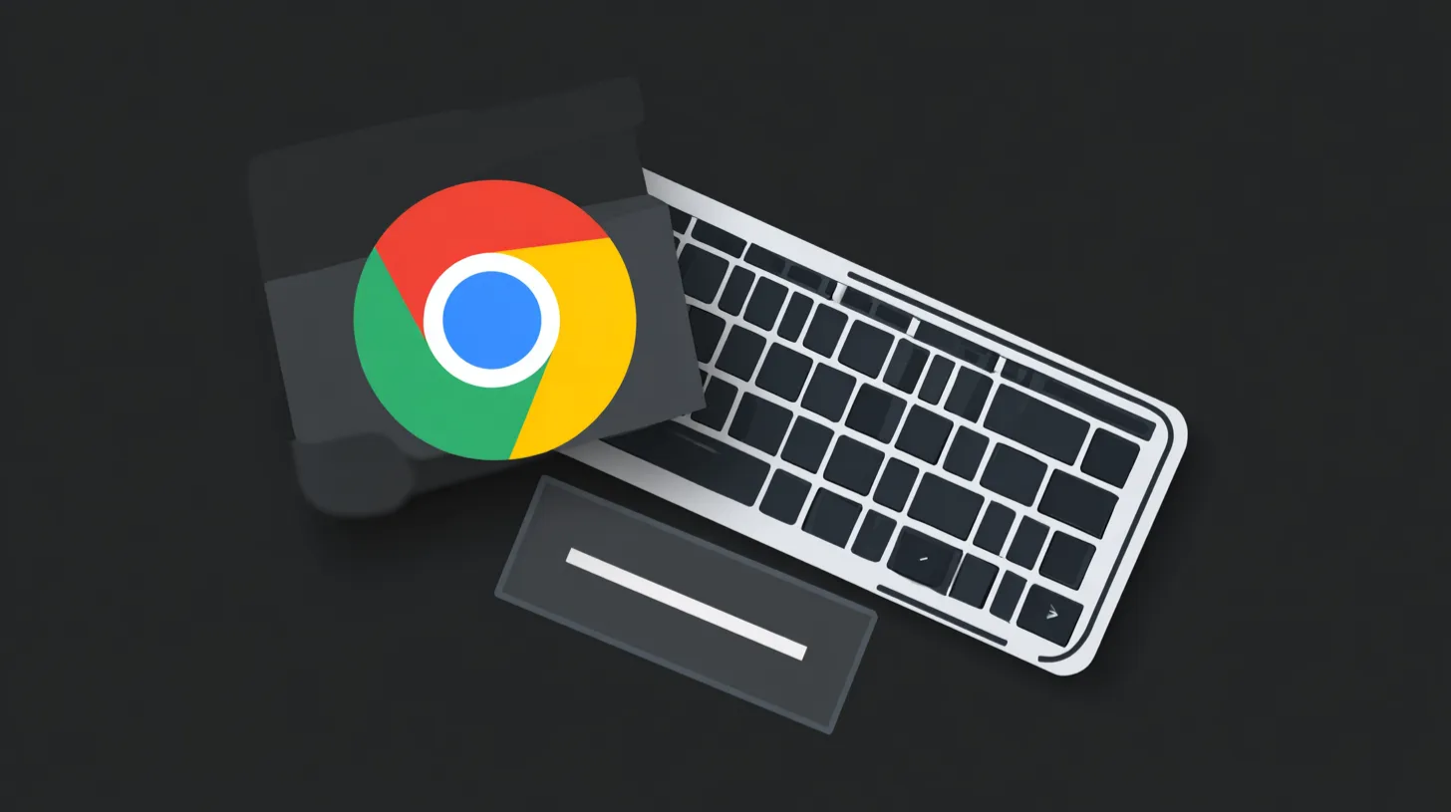
Let's get started!

Slide 9
Links
Chrome DevTools Docs
https://developer.chrome.com/docs/devtools
Chrome for Developers YouTube Channel
https://www.youtube.com/@ChromeDevs

Slide 10


Thank you!
Luca Del Puppo
@puppo92
Nearform_
luca@delpuppo.net

Slide 11
Bye Bye 👋, I'm
Luca
!
Nearform_
AI Native Engineer
GDE
Web Technologies
delpuppo.net
puppo
puppo92
lucadelpuppo

Slide 12

Questions

Slide 13
View online
Download PDF
Download PPTX
ChromeDevTools are you
confident in your
expertise?
Luca Del Puppo
Nearform_

