Slide 1









View online
Download PDF
Download PPTX
AI in the Browser
Am I Still Waiting for It?
Luca Del Puppo
Nearform_

Slide 2







Hi 👋, I'm
Luca
!
Nearform_
AI Native Engineer
GDE
Web Technologies
delpuppo.net
puppo
puppo92
lucadelpuppo

Slide 3
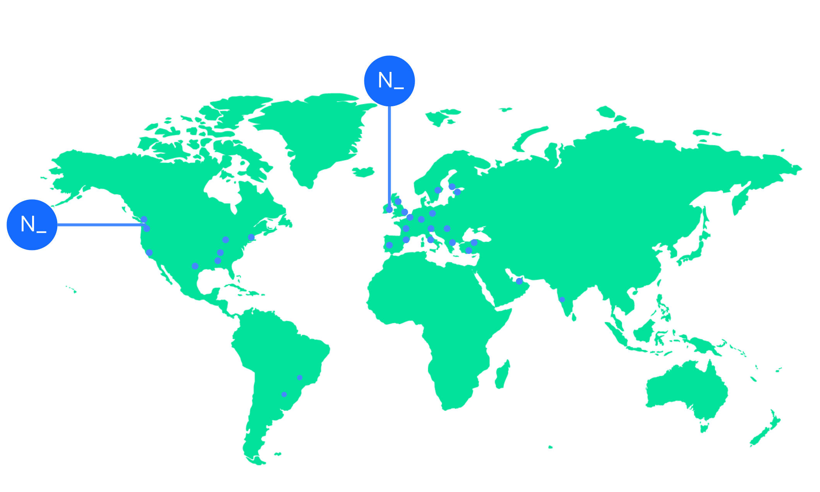

We’re an independent team of engineers, designers and
Nearform’s commitment to Open Source
strategists who build digital solutions and enhanced
capability at pace for ambitious enterprises seeking
15m+
Over 15 million
Downloads
downloads every
enduring business impact.
week
10+
Years experience
700+
Engagements
400+
Nearformers
380+
Customers
1192k+
Thousands of
Contributions
contributions every
28
Countries
year
166+
We maintain many
Packages
popular packages
for the community
We’re hiring!
nearform.com/careers

Slide 4

How the world looks like today
1

Slide 5

How we are changing development products
2

Slide 6
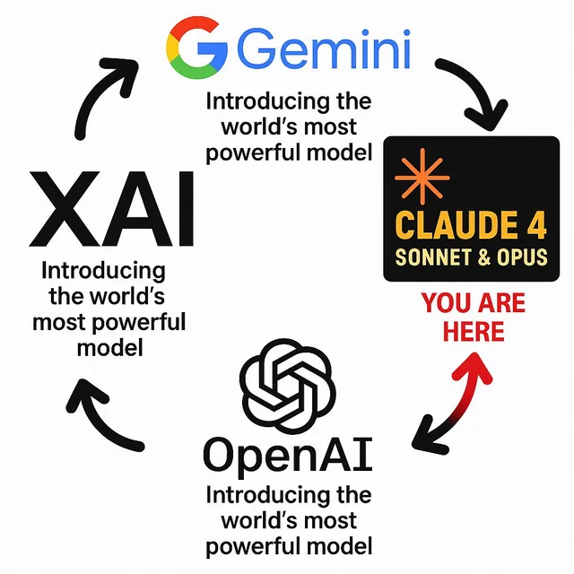
What are the news every day?
3

Slide 7
The Status Quo: Cloud-First AI
1
Most familiar LLMs run on remote servers
GPT-4, large Gemini models
2
This approach grants access to massive models
Hundreds of billions of parameters
3
Pros
Instant scalability, access to the latest, most powerful models
4
The Catch
We often overlook the hidden costs and dependencies of this architecture

Slide 8

The Cost & Latency Bottleneck 1/2
High Cost
Operating on a "pay-per-token" model
Low usage is cheap
But high volume/long-term use can be 2x to 3x more expensive than running locally
Costs are unpredictable
Scale rapidly with adoption

Slide 9
The Cost & Latency Bottleneck 2/2
Network Latency
Inference requests must travel over the internet
Introduces unavoidable delays (latency)
that make true real-time interaction difficult
Stable internet connectivity
Required for every interaction

Slide 10
Privacy and Control Concerns
Data is Leaving the Device
Privacy Risk: Sending sensitive user data to a third-party server (API provider) is a non-
starter for many compliance-sensitive applications
Loss of Control
Limited visibility into the model's execution
Vendor lock-in
Dependency on specific API providers
Zero offline capability
No internet connection means no AI assistance

Slide 11
The Rise of Local LLMs 🏠

Slide 12
The Need for Local Intelligence
Definition
Local LLMs are models downloaded and run directly on the user's device (PC, phone, tablet)
The Enabler
Breakthroughs in Model Quantization - reducing the model's precision to drastically cut size
and memory demands while preserving capability

Slide 13
The Local Promise: Speed and Privacy
1
Superior Privacy
100% client-side computation. Data never leaves the device or network perimeter
2
Low Latency
Inference occurs locally, eliminating network lag for near-instant responses
3
Offline Functionality
Works anywhere, anytime, once the model is loaded
4
Cost-Effective
Zero API costs everything run in the user's environment 🥳

Slide 14


But the Web standards evolve slowly

Slide 15
WebLLM: LLMs in the Browser 🌐

Slide 16
WebLLM
WebLLM
(developed by the MLC-AI team) is a high-performance, in-browser inference engine
Goal
Bring powerful, capable LLMs directly into the standard web browser
Vision
Run LLMs locally just by opening a webpage—zero environment setup

Slide 17
The WebLLM Technology Stack
WebGPU
A new graphics API that grants web code efficient access to the local GPU for tensor
operations (matrix math)
WebAssembly (WASM)
Provides a near-native execution environment for model computations, ensuring high speed
Caching
The model weights (quantized) and WASM modules are downloaded once and cached
locally

Slide 18
WebLLM for Developers
1
Familiarity
Provides an OpenAI-API style interface for easy integration into existing chat and generation
apps
2
Performance
Uses Web Workers to run the heavy inference engine on a separate thread, keeping the
main UI fast and responsive
3
Key Takeaway
WebLLM proved that full LLM inference is technically feasible within the standard, open-
source web stack

Slide 19

How the interface looks likes 1/2
import { CreateMLCEngine, MLCEngine } from "@mlc-ai/web-llm";
// Initialize with a progress callback
const initProgressCallback = (progress) => {
console.log("Model loading progress:", progress);
};
// Using CreateMLCEngine
const engine = await CreateMLCEngine("Llama-3.1-8B-Instruct", { initProgressCallback });
// Direct instantiation
const engineInstance = new MLCEngine({ initProgressCallback });
await engineInstance.reload("Llama-3.1-8B-Instruct");

Slide 20
How the interface looks likes 2/2
const messages = [
{ role: "system", content: "You are a helpful AI assistant." },
{ role: "user", content: "Hello!" }
];
const reply = await engine.chat.completions.create({
messages,
});
console.log(reply.choices[0].message);
console.log(reply.usage);

Slide 21
Links and Videos
Hands-on Chat Demo
https://chat.webllm.ai/
WebLLM: A high-performance in-browser LLM Inference engine
https://www.youtube.com/watch?v=MhTCzq7iTy0

Slide 22
Built-in AI in Chrome: Gemini Nano 🔒

Slide 23
Native AI: Built-in to the Browser
Chrome introduced Built-in AI features
Powered by Gemini Nano, a lightweight LLM designed for on-device use
Gemini Nano
can plug in various models based on the use case
Developers
can request download of a specific model only when needed
Goals
Seamless, deeply integrated, focused on the browsing context

Slide 24
Features Powered by Gemini Nano 1/2
1
Language Detection API
Automatically identifies the language of the webpage for tailored assistance
2
Translator API
Translate webpage content in real-time
3
Summarizer API
Get the gist of an article or webpage immediately

Slide 25
Features Powered by Gemini Nano 2/2
4
Writer API 🧪
Assist with composing emails, messages, and documents
5
Rewriter API 🧪
Rewrite text for clarity, tone, or style
6
Prompt API 🧪
General-purpose interface for custom AI interactions within the browser
7
Proofreader API 🧪
Check grammar and spelling in real-time

Slide 26
How the interface looks for developers 1/3
if ('LanguageDetector' in self) {
const detector = await LanguageDetector.create({
monitor(m) {
m.addEventListener('downloadprogress', (e) => {
console.log(`Downloaded ${e.loaded * 100}%`);
});
},
});
const someUserText = 'Hallo und herzlich willkommen!';
const results = await detector.detect(someUserText);
for (const result of results) {
console.log(result.detectedLanguage, result.confidence);
}
}

Slide 27
How the interface looks for developers 2/3
if ('Translator' in self) {
const translator = await Translator.create({
sourceLanguage: 'es',
targetLanguage: 'fr',
monitor(m) {
m.addEventListener('downloadprogress', (e) => {
console.log(`Downloaded ${e.loaded * 100}%`);
});
},
});
const translation = await translator.translate('Where is the next bus stop, please?');
const stream = translator.translateStreaming(longText);
for await (const chunk of stream) {
console.log(chunk);
}
}

Slide 28
How the interface looks for developers 3/3
if ('Summarizer' in self) {
const summarizer = await Summarizer.create({
monitor(m) {
m.addEventListener('downloadprogress', (e) => {
console.log(`Downloaded ${e.loaded * 100}%`);
});
}
});
const summary = await summarizer.summarize(longText, {
context: 'This article is intended for a tech-savvy audience.',
});
const stream = summarizer.summarizeStreaming(longText, {
context: 'This article is intended for junior developers.',
});
for await (const chunk of stream) {
console.log(chunk);
}
}

Slide 29
Typescript types
npm install -D @types/dom-chromium-ai

Slide 30
WebMCP: The Agentic Web 🤖

Slide 31
What is WebMCP?
A proposed browser standard
Allows web developers to expose their app functionality as "tools" that AI agents and
assistive technologies can invoke
MCP-inspired, browser-native
Web pages become like MCP servers, but tools run in client-side JavaScript — no backend
server needed
Two APIs
Declarative API for standard HTML form actions, and Imperative API for complex dynamic
interactions
Human-in-the-loop
Designed for cooperative workflows where users and agents collaborate within the same
web interface

Slide 32
WebMCP for Developers
if ("modelContext" in window.navigator) {
window.navigator.modelContext.registerTool({
name: "add-todo",
description: "Add a new todo item to the list",
inputSchema: {
type: "object",
properties: {
text: { type: "string", description: "The text of the todo item" }
},
required: ["text"]
},
execute({ text }, agent) {
addTodo(text);
return {
content: [{ type: "text", text: `Todo "${text}" added!` }]
};
}
});
}

Slide 33
Demo of Gemini Nano in Action 🧑‍💻

Slide 34
Links and Videos
Built-in AI Documentation
https://developer.chrome.com/docs/ai/built-in
Build a guessing game with the Prompt API
https://developer.chrome.com/blog/ai-guessing-game?hl=en
Practical built-in AI with Gemini Nano in Chrome
https://www.youtube.com/watch?v=CjpZCWYrSxM
Lessons learned from being customer zero of Chrome's built-in APIs
https://www.youtube.com/watch?v=surh_D8CU9A

Slide 35
Conclusion & The Future 🚀

Slide 36

The Hybrid Future: Cloud + Client
The
future
of
web
AI
is
not
Cloud
vs.
Local
,
but
Cloud
+
Client
Cloud:
Handles
massive,
general-purpose
tasks
Client:
Handles
fast,
private,
contextual
tasks
The
browser
is
evolving
from
a
mere
document
viewer
into
the
primary
AI
Agent
platform

Slide 37
But with slow adoption

Slide 38


Thank you!
Luca Del Puppo
@puppo92
Nearform_
luca@delpuppo.net

Slide 39


GitHub Repos
AI in the Browser
Recipe Radar with AI
Explore the code and examples
Explore the code and examples

Slide 40
Bye Bye 👋, I'm
Luca
!
Nearform_
AI Native Engineer
GDE
Web Technologies
delpuppo.net
puppo
puppo92
lucadelpuppo

Slide 41
View online
Download PDF
Download PPTX
AI in the Browser Am I Still
Waiting for It?
Luca Del Puppo
Nearform_

