Slide 1


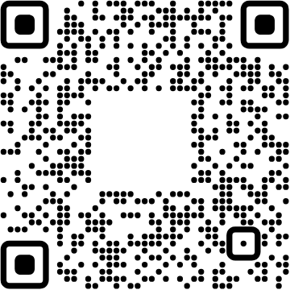
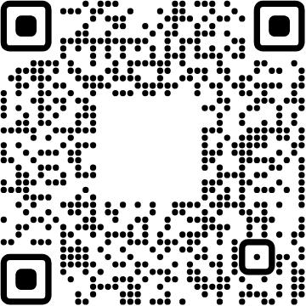
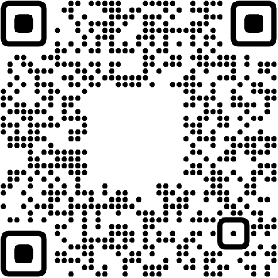




View online
Download PDF
Download PPTX
AI Agents Made Simple
Luca Del Puppo
Nearform_

Slide 2
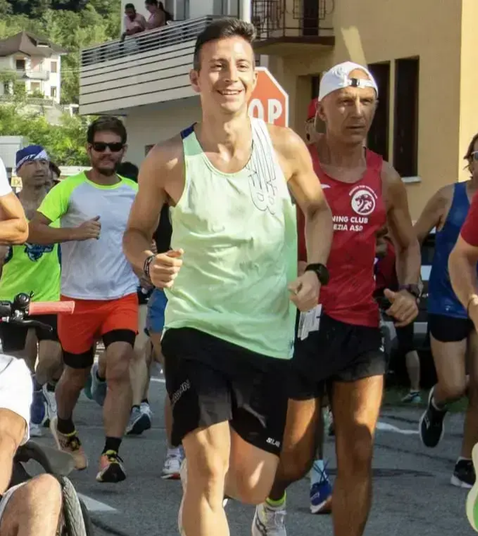
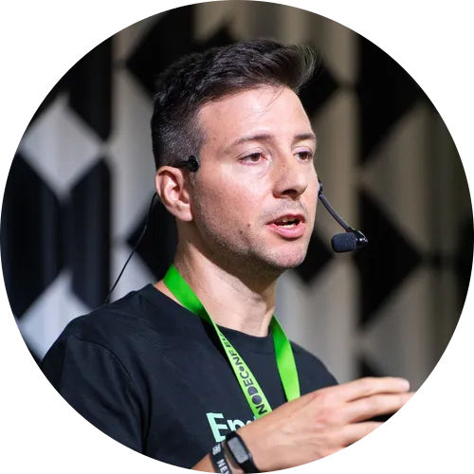
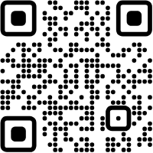




Hi 👋, I'm
Luca
!
Nearform_
AI Native Engineer
GDE
Web Technologies
delpuppo.net
puppo
puppo92
lucadelpuppo

Slide 3
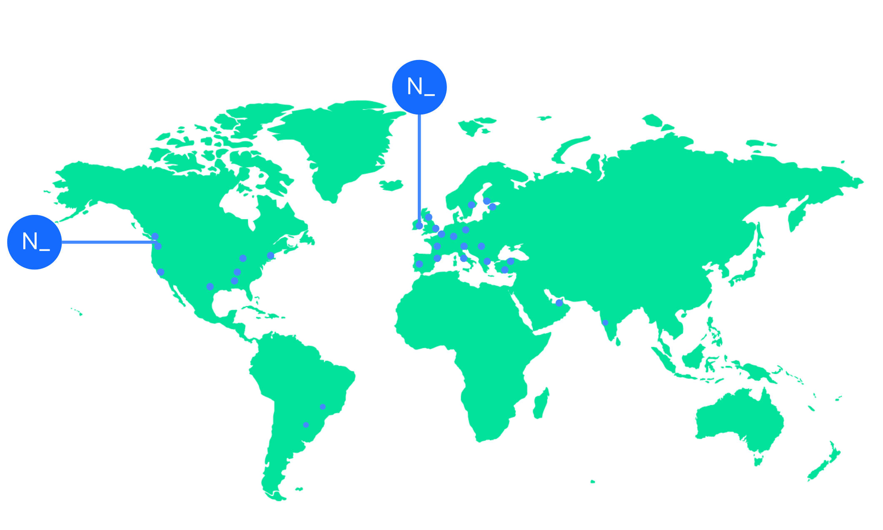

We’re an independent team of engineers, designers and
Nearform’s commitment to Open Source
strategists who build digital solutions and enhanced
capability at pace for ambitious enterprises seeking
15m+
Over 15 million
Downloads
downloads every
enduring business impact.
week
10+
Years experience
700+
Engagements
400+
Nearformers
380+
Customers
1192k+
Thousands of
Contributions
contributions every
28
Countries
year
166+
We maintain many
Packages
popular packages
for the community
We’re hiring!
nearform.com/careers

Slide 4
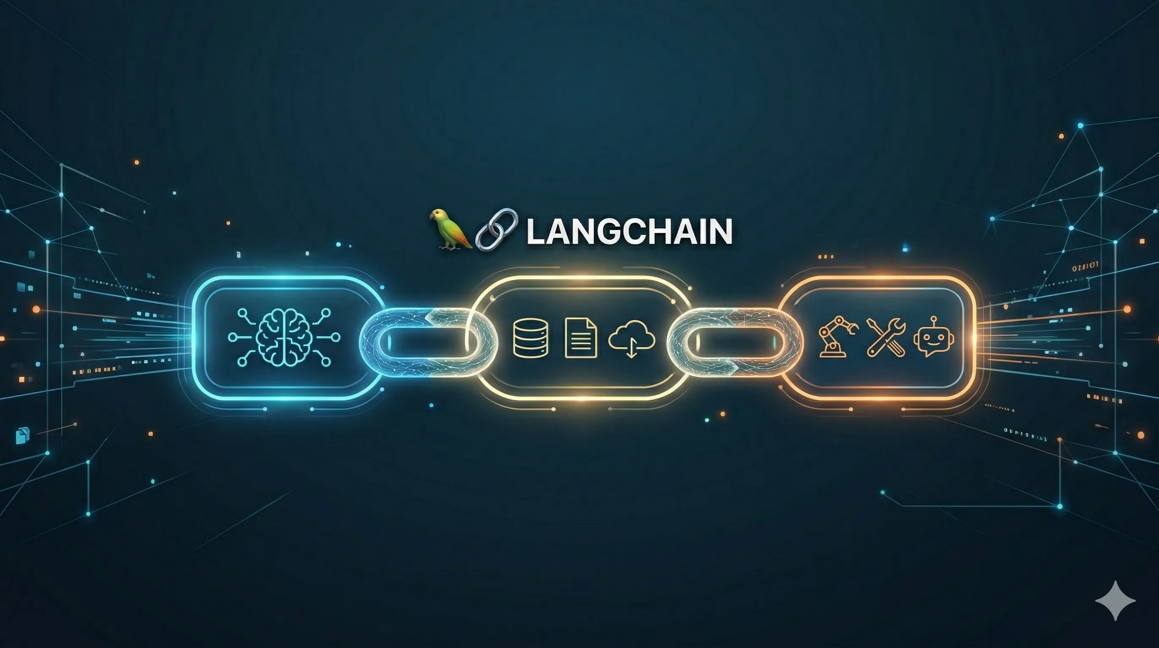
DEMO!

Slide 5

Open Source Frameworks
1
LangChain
Quick start agents with any model provider
2
LangGraph
Build reliable agents with low-level control
3
Deep Agents
Build long-running agents for complex tasks

Slide 6
Platform Products (LangSmith 🤑)
1
Observability
See exactly what your agents are doing
2
Evaluation
Score and improve agent performance
3
Deployment
Ship and scale agents in production
4
Fleet
Agents for the whole company

Slide 7
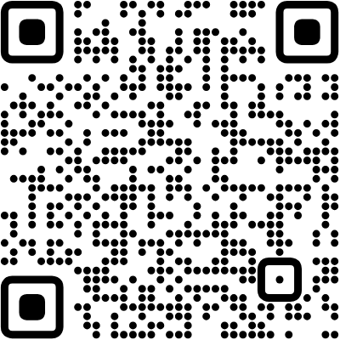
Source code
1
GitHub Repository
AI Agents Made Simple

Slide 8
Links
LangChain Docs
https://docs.langchain.com/
LangChain YouTube Channel
https://www.youtube.com/@LangChainDefault
with vertical items

Slide 9


Thank you!
Luca Del Puppo
@puppo92
Nearform_
luca@delpuppo.net

Slide 10
Bye Bye 👋, I'm
Luca
!
Nearform_
AI Native Engineer
GDE
Web Technologies
delpuppo.net
puppo
puppo92
lucadelpuppo

Slide 11
View online
Download PDF
Download PPTX
AI Agents Made Simple
Luca Del Puppo
Nearform_

